Slide 2
Sexual orientation
one's inherent attraction to a sexual partner of a certain gender, or the absence of gender preference in a sexual relationship; one’s identity as asexual, bisexual, heterosexual, gay, pansexual, etc.

Slide 3
Gender identity
a person's inner sense of being male or female, usually developed during early childhood as a result of parental rearing practices and societal influences and strengthened during puberty by hormonal changes.

Slide 4
SOGI
Notes:
“Yuck” or “Yes?”

Slide 5
SOGI Neither ‘Yuck’ nor ‘Yes’

Slide 6
Where do we even begin this?
Notes:
Christians begin with the authoritative Word of God.

Slide 7
Genesis 1.1
In the beginning God created the heavens and the earth.

Slide 8
Genesis 1.27
So God created mankind in his own image, in the image of God he created them; male and female he created them.

Slide 9
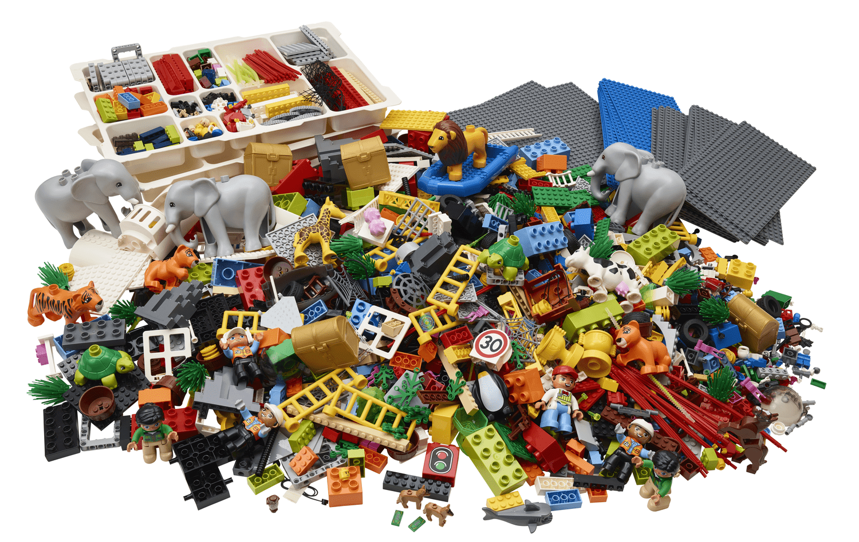
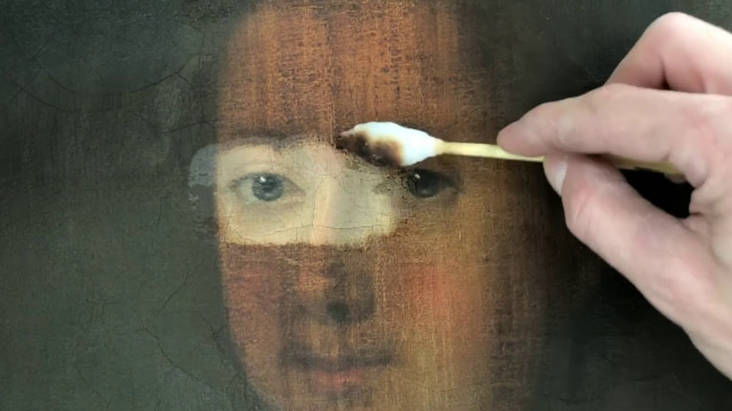
Lego Kit vs. Art Restorer

Slide 10
Our identity is created by God, not invented by us
Notes:
We know who we are in God, and does not have to ‘find’ ourselves.
When I was growing up, my main concern is who I want to be when I grow up. Today that question can be answered differently. It is hard enough to know the answer to the first, now to have to answer the second one? And the whole idea of fluidity does not help as well.

Slide 11
True freedom is being who we are
Notes:
True freedom, according to Scripture, is found not in asserting our radical independence and trying to be who we’re not made to be. True freedom is found in embracing and being who we are.
Made in the image of God.
Analogy of being a fish. I have heard of people wanting to be a cat, but so far, no fish or aquaman.

Slide 12
Identity is a given
Made in the image of God
Creatures, not machines
You are a human being
Notes:
True freedom, according to Scripture, is found not in asserting our radical independence and trying to be who we’re not made to be. True freedom is found in embracing and being who we are.
Made in the image of God.
Analogy of being a fish. I have heard of people wanting to be a cat, but so far, no fish or aquaman.

Slide 13
Embodied creature
Notes:
View of soul and the body. Even in our Christian upbringing we often differentiate between soul and body. Soul lives on, but body become dust. In the NT, Paul has to fight this idea that the body is restrictive.
Not souls trapped in human bodies.

Slide 14
1 Timothy 4:1-5
The Spirit clearly says that in later times some will abandon the faith and follow deceiving spirits and things taught by demons. ²Such teachings come through hypocritical liars, whose consciences have been seared as with a hot iron. ³They forbid people to marry and order them to abstain from certain foods,

Slide 15
1 Timothy 4:1-5
which God created to be received with thanksgiving by those who believe and who know the truth. ⁴For everything God created is good, and nothing is to be rejected if it is received with thanksgiving, ⁵because it is consecrated by the word of God and prayer.

Slide 16
1 Corinthians 6:13-20
You say, “Food for the stomach and the stomach for food, and God will destroy them both.” The body, however, is not meant for sexual immorality but for the Lord, and the Lord for the body. ¹⁴By his power God raised the Lord from the dead, and he will raise us also. ¹⁵Do you not know that your bodies are

Slide 17
1 Corinthians 6:13-20
members of Christ himself? Shall I then take the members of Christ and unite them with a prostitute? Never! ¹⁶Do you not know that he who unites himself with a prostitute is one with her in body? For it is said, “The two will become one flesh.” ¹⁷But whoever is united with the Lord is one with him in spirit.

Slide 18
1 Corinthians 6:13-20
¹⁸Flee from sexual immorality. All other sins a person commits are outside the body, but whoever sins sexually, sins against their own body. ¹⁹Do you not know that your bodies are temples of the Holy Spirit, who is in you, whom you have received from God? You are not your own; ²⁰you were bought at a price. Therefore honor God with your bodies.

Slide 19
Psalm 139:13-14
For you created my inmost being; you knit me together in my mother’s womb. ¹⁴I praise you because I am fearfully and wonderfully made; your works are wonderful, I know that full well.

Slide 20
Sexual creature

Slide 21
Genesis 1.27
So God created mankind in his own image, in the image of God he created them; male and female he created them.
Notes:
The image of God is both ‘male’ and ‘female.’

Slide 22
The Fall

Slide 23
Romans 1.21-24
For although they knew God, they neither glorified him as God nor gave thanks to him, but their thinking became futile and their foolish hearts were darkened. ²²Although they claimed to be wise, they became fools ²³and exchanged the glory of the immortal God for images made to look like a mortal human

Slide 24
Romans 1.21-24
being and birds and animals and reptiles.
²⁴Therefore God gave them over in the sinful desires of their hearts to sexual impurity for the degrading of their bodies with one another.

Slide 25
Disordered bodies
Disordered minds
Disordered hearts
Notes:
True freedom, according to Scripture, is found not in asserting our radical independence and trying to be who we’re not made to be. True freedom is found in embracing and being who we are.
Made in the image of God.
Analogy of being a fish. I have heard of people wanting to be a cat, but so far, no fish or aquaman.

Slide 26
The Reorder

Slide 27
Romans 3:22-24
This righteousness is given through faith in Jesus Christ to all who believe. There is no difference between Jew and Gentile, ²³for all have sinned and fall short of the glory of God, ²⁴and all are justified freely by his grace through the redemption that came by Christ Jesus.

Slide 28
The i prefix
Notes:
The roots of the profound individualism that marks our culture go back to the period of the Enlightenment 300 years ago, when intellectuals began to assert the primacy of human reason over divine revelation. Most people have never read the works of philosophers like Voltaire and Rousseau, but their influence has gradually trickled down into our whole society so that it affects us all. The Enlightenment began with great confidence that reason could lead us to the truth, but that optimism gradually disappeared. Even the greatest human thinkers can’t agree on fundamental issues. And so, having rejected revelation and lacking confidence in reason, our culture has now largely rejected the concept of objective truth, at least when it comes to big issues, such as meaning and morality. So where does this leave us? With ourselves as individuals. If we think that truth is subjective, then we certainly won’t let any external authority tell us what to think or how to behave—whether it’s the government, a religion or our family. It’s up to us to draw our own conclusions and live our own lives.

Slide 29
No matter what they tell you;
no matter what they say;
no matter what they teach you;
what you believe is true.
Notes:
Facebook – got so many different gender preferences that they finally scrap off and just put ‘custom.’

Slide 30
Change or Suppression (Conversion) Practices Prohibition Act 2021
Notes:
17th February 2022

Slide 31
“To affirm that a person's sexual orientation or gender identity is not broken and in need of fixing.”

Slide 32
Clash of worldviews

Slide 33
The Bible says: Your body is your sexual identity—let your mind be conformed to it.
Our culture says: Your psychology is your sexual identity—let your body be conformed to it.

Slide 34
The world care very little about what the church thinks.
Notes:
Philip Jansen’ sermon once on evangelism. You do it in the church. Where we are sitting now is what they call a parish hall. Built for the community.
Lesslie Newbigin came back to UK after 30 years as a missionary in India, and found the profound change in society. Yet, the church still thinks they were in the era of Christendom!
We spent countless hours debating and trying to understand the theological views on SOGI.
Today, the community cares very little what we think.

Slide 35
How many of you actually bother or reach out to people who are LGBTQI?
Notes:
We spent countless hours debating and trying to understand the theological views on SOGI.
Is it about theological debates or about us wanting to truly relate and reach out to people who are LGBTQI?

Slide 36
Yes, I bother. What should I do?

Slide 37
See LGBTQI as people, not issues.
Notes:
They are made in the image of God, just like me. They are fallen people, just like me. They have needs, just like me.
Do not single them out as sinful people.

Slide 38
John 3:16
For God so loved the world that he gave his one and only Son, that whoever believes in him shall not perish but have eternal life.

Slide 39
1 Corinthians 6:9
Or do you not know that wrongdoers will not inherit the kingdom of God? Do not be deceived: Neither the sexually immoral nor idolaters nor adulterers nor men who have sex with men[a] 10 nor thieves nor the greedy nor drunkards nor slanderers nor swindlers will inherit the kingdom of God

Slide 40
Point LGBTQI people to Jesus.
Notes:
Let Jesus change them.
Growing up, there were some thing you just don’t do as a Christian – smoking, drinking, dancing, going to the cinemas, etc. And we require people to be someone we set standard on before we baptise them or say you are allowed to be a Christian. If you feel that way, I want you to know that’s not of Jesus. You come as you are, relate with him, and let him change you.
Jesus is the one who will change the person.
Give them time to grow.
Faith shapes desires, not the other way round.

Slide 41
Philippians 1:6 …being confident of this, that he who began a good work in you will carry it on to completion until the day of Christ Jesus.
Notes:
Let Jesus change them.
Growing up, there were some thing you just don’t do as a Christian – smoking, drinking, dancing, going to the cinemas, etc. And we require people to be someone we set standard on before we baptise them or say you are allowed to be a Christian. If you feel that way, I want you to know that’s not of Jesus. You come as you are, relate with him, and let him change you.
Jesus is the one who will change the person.

Slide 42
For parents…

Slide 43
Pray for your children regularly.
Impart grace.
Keep the communication channels open. Do not shut them out.
Children tend to grow out of certain feelings.
Ultimately trust the Lord for our children.

Slide 44
Pray for people you know who are LGBTQI.

