Slide 1
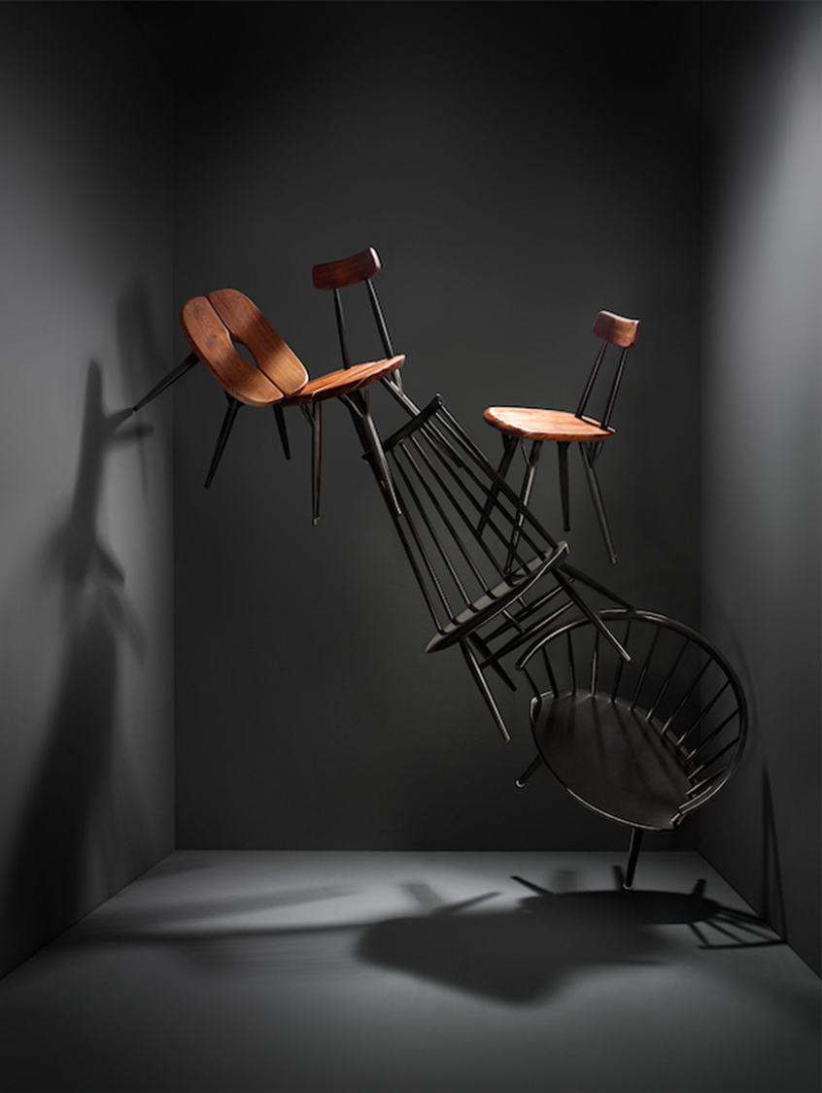
Still and Steady
Psalm 46:1-11

Slide 2
Psalm 46:1-11
¹God is our refuge and strength, an ever-present help in trouble.
²Therefore we will not fear, though the earth give way and the mountains fall into the heart of the sea,
³though its waters roar and foam and the mountains quake with their surging.

Slide 3
Psalm 46:1-11
⁴There is a river whose streams make glad the city of God, the holy place where the Most High dwells.
⁵God is within her, she will not fall; God will help her at break of day.
⁶Nations are in uproar, kingdoms fall; he lifts his voice, the earth melts.
⁷The LORD Almighty is with us; the God of Jacob is our fortress.

Slide 4
Psalm 46:1-11
⁸Come and see what the LORD has done, the desolations he has brought on the earth.
⁹He makes wars cease to the ends of the earth.
He breaks the bow and shatters the spear; he burns the shields with fire.
¹⁰He says, “Be still, and know that I am God; I will be exalted among the nations, I will be exalted in the earth.”
¹¹The LORD Almighty is with us; the God of Jacob is our fortress.

Slide 5
3 Fears
Natural disasters vv. 2-3
Political upheaval vv. 4-6
Wars vv. 8-9
Notes:
The above is a national list for Israel in the OT.

Slide 6
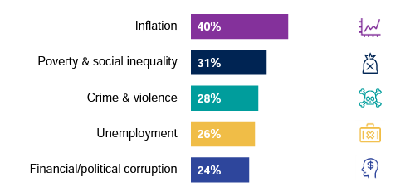
What worries the world?
Q. Which three of the following topics do you find the most worrying in your country?
© Ipsos | What Worries the World
Notes:
Ipsos’ What Worries the World survey tracks public opinion on the most important social and political issues across 29 countries today, drawing on over 10 years of data to place the latest scores in context.
World list for today.
What about your individual list?
Today’s list could look very different. You can add your own list to this:
Family – where will they end up in?
Wars in Ukraine
Changes to values

Slide 7
Fear Busters
Refuge v. 1
Strength v.1
Help v.1
Company vv. 4-5, 7
Fortress vv. 7,11

Slide 8
“Be still, and know that I am God.”

Slide 9
The call to be still is a call to surrender.

Slide 10
How do you get to being still and steady?
Come Matthew 11:28-30

Slide 11
Matthew 11:28
Come to me, all you who are weary and burdened, and I will give you rest.
Notes:
Do you come to Jesus first or you go all over?

Slide 12
How do you get to being still and steady?
Come Matthew 11:28-30
Compare Romans 8:18

Slide 13
Romans 8:18
I consider that our present sufferings are not worth comparing with the glory that will be revealed in us.
Notes:
Do you come to Jesus first or you go all over?

Slide 14
How do you get to being still and steady?
Come Matthew 11:28-30
Compare Romans 8:18
Confess Romans 8:31

Slide 15
Romans 8:31
What, then, shall we say in response to these things? If God is for us, who can be against us?
Notes:
Do you come to Jesus first or you go all over?

Slide 16
How do you get to being still and steady?
Come Matthew 11:28-30
Compare Romans 8:18
Confess Romans 8:31
Carry Galatians 6:2

Slide 17
Galatians 6:2
Carry each other’s burdens, and in this way you will fulfill the law of Christ.
Notes:
Do you come to Jesus first or you go all over?

Slide 18
How do you get to being still and steady?
Come Matthew 11:28-30
Compare Romans 8:18
Confess Romans 8:31
Carry Galatians 6:2
Cry-out Philippians 4:6

Slide 19
Philippians 4:6
Do not be anxious about anything, but in every situation, by prayer and petition, with thanksgiving, present your requests to God.
Notes:
Do you come to Jesus first or you go all over?

Slide 20
How do you get to being still and steady?
Come Matthew 11:28-30
Compare Romans 8:18
Confess Romans 8:31
Carry Galatians 6:2
Cry-out Philippians 4:6
Consider Philippians 4:8

Slide 21
Philippians 4:8
Finally, brothers and sisters, whatever is true, whatever is noble, whatever is right, whatever is pure, whatever is lovely, whatever is admirable—if anything is excellent or praiseworthy—think about such things.
Notes:
Do you come to Jesus first or you go all over?

Slide 22
How do you get to being still and steady?
Come Matthew 11:28-30
Compare Romans 8:18
Confess Romans 8:31
Carry Galatians 6:2
Cry-out Philippians 4:6
Consider Philippians 4:8
Notes:
Invite keyboardist to play.

Slide 23
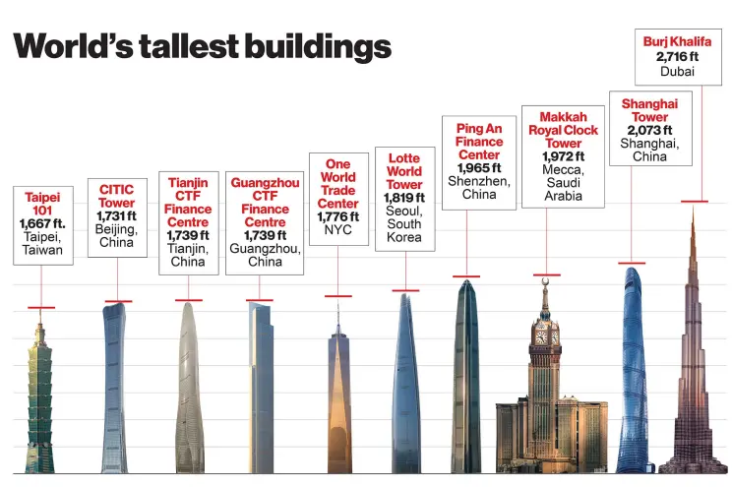
Notes:
Dampers: Shock Absorbers for Supertalls
To help counter the shifting and swaying of building, engineers also utilize dampers, massive devices that shift and help stabilize tall structures like counterweights.

Slide 24
“Not all storms come to disrupt your life, some come to clear your path” — Paulo Coelho
Notes:
Sounds good, but let me end with something better.

Slide 25
Romans 8:28
And we know that in all things God works for the good of those who love him, who have been called according to his purpose.
Notes:
Do you come to Jesus first or you go all over?

