Slide 1
A Thirst for God’s Word

Slide 2
Photosynthesis

Slide 3
Photosynthesis
The process by which plants, some bacteria and some protistans use the energy from sunlight to produce glucose from carbon dioxide and water. This glucose can be converted into pyruvate which releases adenosine triphosphate by cellular respiration. Oxygen is also formed.

Slide 4
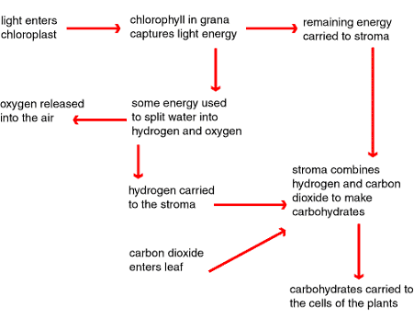
Photosynthesis
The process by which plants, some bacteria and some protistans use the energy from sunlight to produce glucose from carbon dioxide and water. This glucose can be converted into pyruvate which releases adenosine triphosphate by cellular respiration. Oxygen is also formed.

Slide 5
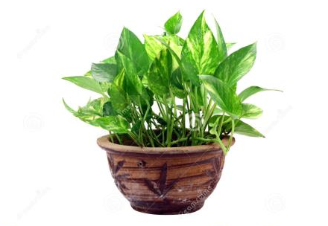
Photosynthesis

Slide 6
A Thirst for God’s Word

Slide 7
A Thirst for God’s Word
Hebrews 5:11-14
We have much to say about this, but it is hard to make it clear to you because you no longer try to understand. ¹² In fact, though by this time you ought to be teachers, you need someone to teach you the elementary truths of God’s word all over again. You need milk, not solid food! ¹³ Anyone who lives on milk, being still an infant, is not acquainted with the teaching about righteousness. ¹⁴ But solid food is for the mature, who by constant use have trained themselves to distinguish good from evil.

Slide 8
A Thirst for God’s Word
Matthew 4:3-4
Then Jesus was led by the Spirit into the wilderness to be tempted by the devil. ² After fasting for forty days and forty nights, he was hungry. ³ The tempter came to him and said, ‘If you are the Son of God, tell these stones to become bread.’ Jesus answered, ‘It is written: “People do not live on bread alone, but on every word that comes from the mouth of God.”’

Slide 9
A Thirst for God’s Word
2 Timothy 3:14-17
But as for you, continue in what you have learned and have become convinced of, because you know those from whom you learned it, and how from infancy you have known the Holy Scriptures, which are able to make you wise for salvation through faith in Christ Jesus. All Scripture is God-breathed and is useful for teaching, rebuking, correcting and training in righteousness, so that the servant of God may be thoroughly equipped for every good work.

Slide 10
1. The Bible is God’s revelation of himself

Slide 11
2. The Bible is God-breathed

Slide 12
2. The Bible is God-breathed
Hebrews 4:12
For the word of God is living and active. Sharper than any double-edged sword, it penetrates even to dividing soul and spirit, joints and marrow; it judges the thoughts and attitudes of the heart.

Slide 13
3. The Bible is God’s guidebook for successful living

Slide 14
3. The Bible is God’s guidebook for successful living
Bibles that are falling apart
are usually owned by people who aren’t

Slide 15
3. The Bible is God’s guidebook for successful living
Psalm 1:1-3
¹ Blessed is the one who does not walk in step with the wicked or stand in the way that sinners take or sit in the company of mockers, ² but whose delight is in the law of the Lord, and who meditates on his law day and night. ³ That person is like a tree planted by streams of water, which yields its fruit in season and whose leaf does not wither – whatever they do prospers.

Slide 16
3. The Bible is God’s guidebook for successful living
Joshua 1:8-9
Keep this Book of the Law always on your lips; meditate on it day and night, so that you may be careful to do everything written in it. Then you will be prosperous and successful. Have I not commanded you? Be strong and courageous. Do not be afraid; do not be discouraged, for the Lord your God will be with you wherever you go.’

Slide 17
3. The Bible is God’s guidebook for successful living
Psalm 119:9-11
How can a young person stay on the path of purity? By living according to your word. ¹⁰ I seek you with all my heart; do not let me stray from your commands. ¹¹ I have hidden your word in my heart that I might not sin against you.

Slide 18
A Thirst for God’s Word

Slide 19
A Thirst for God’s Word
Read the Bible every day

Slide 20
A Thirst for God’s Word
Read the Bible every day

Slide 21
A Thirst for God’s Word
Read the Bible every day
Use a devotional study guide

Slide 22
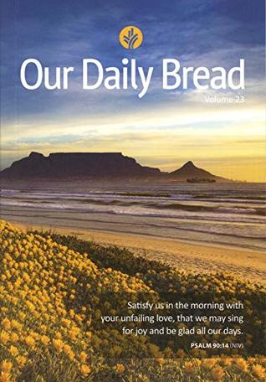

Slide 23
A Thirst for God’s Word
Read the Bible every day
Use a devotional study guide
Commit to a Cell Group

